Slide 1
Lecture 4: Regression Analysis
Er.Roshan Shrestha
roshan.shrestha@islingtoncollege.edu.np

Slide 2
Agenda
Regression
Linear Regression
Overfitting and underfitting
Bias variance
Correlation
Loss functions
Ridge and Lasso Regression

Slide 3
Regression
supervised learning technique in ML and statistics that models the relationship between a dependent variable (target) and one or more independent variables (features).
It’s about target and features
The goal of regression is to predict a continuous output, unlike classification, which predicts discrete labels or categories.
output is usually a real-valued number
Predicting someone's income.
Forecasting temperature.
Estimating sales revenue.

Slide 4
Regression
Linear Regression (predicting a value using a straight-line relationship).
Polynomial Regression (predicting values using a curved relationship).
Logistic Regression (though technically a classifier, it uses regression techniques).
Ridge and Lasso Regression (regularized regression methods for controlling overfitting).

Slide 5
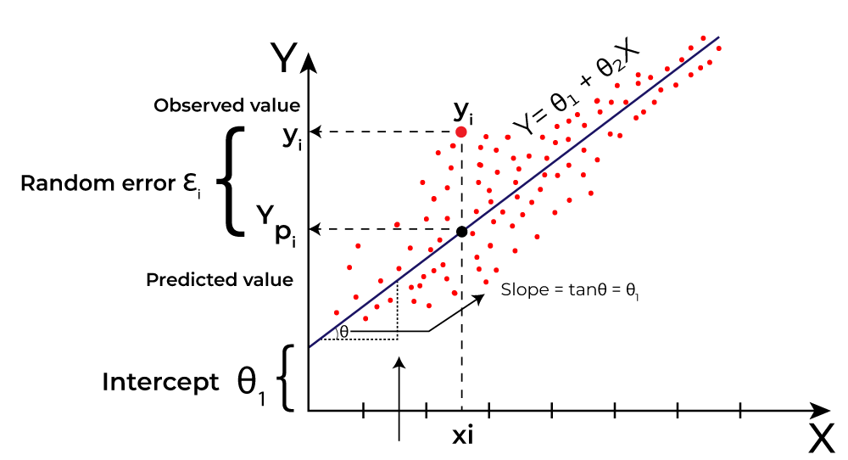
Linear Regression
one of the simplest and most commonly used regression techniques
finds the best line that minimizes the differences between predicted and actual values
assumes a linear relationship between the dependent variable (target) and the independent variables (features)
analyze and forecast data trends

Slide 6
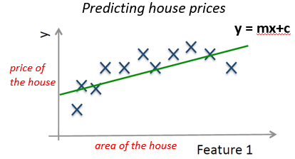
Linear Regression
Dependent Variable (Y): The variable to predict (the output).
Independent Variable(s) (X): The variables to make predictions (the inputs).
Linear Relationship: The model assumes that the relationship between X and Y can be represented as a straight line.

Slide 7
Assumptions of Linear Regression:
Linearity:
The relationship between the dependent and independent variables is linear.
Independence:
The observations are independent of each other.
Homoscedasticity:
The residuals (errors) have constant variance (i.e., they are equally spread out across the regression line).
Normality of Residuals:
The residuals (differences between the observed and predicted values) are normally distributed.

Slide 8
Types of Linear Regression
Simple Linear Regression
Multiple Linear Regression

Slide 9
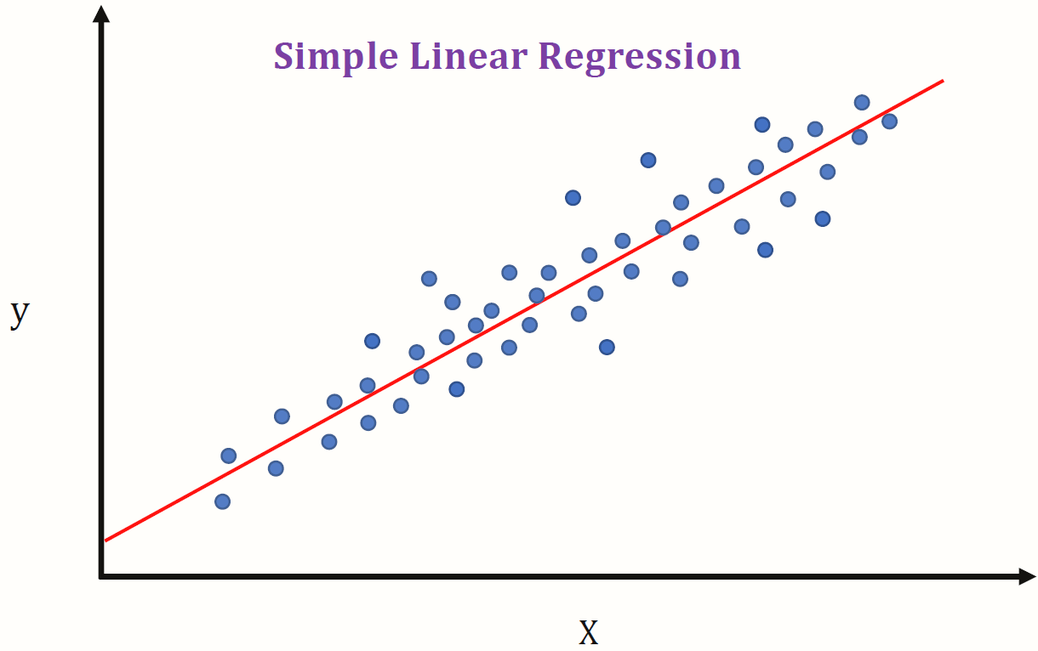
Simple Linear Regression
one independent variable and one dependent variable
Equation for simple linear regression:
y is the dependent variable
X is the independent variable
β0 is the intercept
β1 is the slope

Slide 10
Multiple Linear Regression
involves more than one independent variable and one dependent variable.
Equation for multiple linear regression:
where
y: dependent variable
X1, X2, …, Xn: independent variables
Β0: intercept
β1, β2, …, βn: slopes

Slide 11
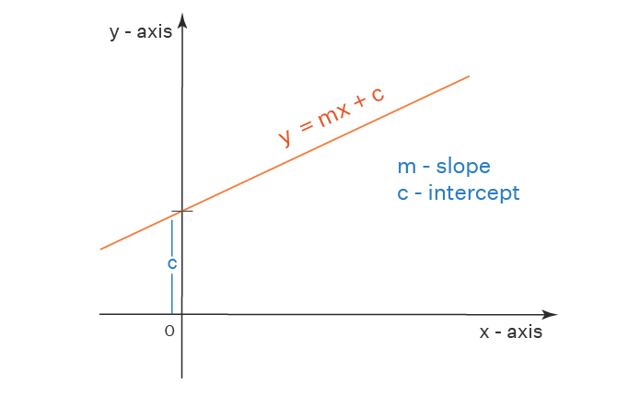
Intercept and slopes
In the regression line
𝑦 = 𝑚𝑥+c
𝑚 =(slope)
determines the angle or steepness of the line.
c =(intercept)
determines where the line crosses the y-axis.

Slide 12
Intercept
is the starting point of the regression line when there is no influence from the independent variables.
gives the predicted value of y when all predictors are equal to zero.
While predicting house price (y) based on the number of square feet (x), if the intercept β0​ is 5,00000, it means:
If a house has 0 square feet (hypothetically), its predicted price would be 5,00000.
The intercept might not always have real-world meaning, especially if zero values for predictors are unrealistic (e.g., a house with 0 square feet), but it is still an essential component of the model.
It’s a mathematical artifact of the linear equation

Slide 13
Slope (β)
The slope (or coefficient), β, shows the change in y for a one-unit increase in x, holding all other variables constant.
The slope represents the rate of change in the dependent variable as the independent variable changes.
A positive slope means that as x increases, y also increases.
A negative slope means that as x increases, y decreases.
Example:
house price example, let’s say the slope β1​ is 200. This means:
For every additional square foot of space, the predicted house price increases by 200.
In the case of multiple regression (with multiple slopes), each slope tells us the change in y for a one-unit increase in its corresponding variable, assuming all other variables stay the same.

Slide 14
For a regression equation like y=50,000+200x:
Intercept (β0=50,000):
When x=0, the predicted price is 50,000.
Slope (β1=200):
For each additional square foot, the price increases by $200.
So, if we plug in a value of x=1,000 square feet:
y=50,000+(200×1,000)=50,000+200,000=250,000

Slide 15
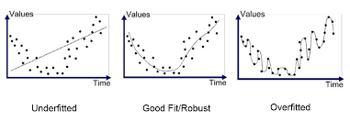
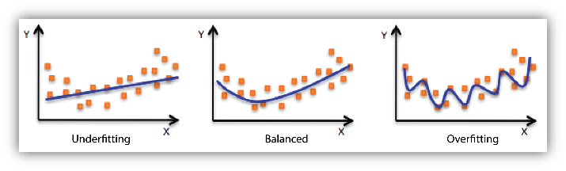
Underfitting and overfitting
two common problems that can arise in machine learning models
how well (or poorly) a model learns from the training data and how it generalizes to new, unseen data.

Slide 16
Underfitting
Underfitting occurs when a model is too simple to capture the underlying pattern in the data.
results in poor performance on both training and test data because the model doesn’t learn the relationship between features and the target variable well enough.

Slide 17
Underfitting
The model may have a high bias (it makes consistent errors).
The line of best fit doesn’t capture the trend in the data accurately.
Predictions are often inaccurate for both training and test data.
Example: Imagine predicting the student’s mark based only on the study hours of the student, but our dataset has a complex relationship with additional factors like resources, sleep cycle, diets etc.
If we use a simple linear regression (a straight line), the model might underfit, failing to capture the complexity needed to make accurate predictions.

Slide 18
Underfitting
Solution:
Adding more features
Including additional predictors like sleep hours, resources, attendance
Choosing more complex models
Use of more complex models

Slide 19
Overfitting
occurs when a model is too complex and learns the training data too well, including its noise and random fluctuations.
This model performs well on training data but poorly on test data because it doesn’t generalize well.

Slide 20
Overfitting
The model has high variance (predictions fluctuate significantly with small changes in data).
The line of best fit may follow the noise in the data rather than capturing the general trend.
Training error is low, but test error is high, as the model is too tailored to the training data.
If we fit a high-degree polynomial curve to data that doesn’t require it, the model might “wiggle” through every data point in the training set, resulting in a highly complex curve. Such a model overfits by capturing random noise in the data, leading to poor performance on new data.

Slide 21
Overfitting
Solution for overfitting
Simplify the model: Use fewer predictors or reduce the polynomial degree in polynomial regression.
Regularization: Techniques like Ridge and Lasso regression penalize overly complex models, helping them generalize better.

Slide 22
Bias and Variance
Bias and variance are two critical sources of error in machine learning models, and they relate directly to a model's ability to generalize from training data to unseen data.
Together, they make up the bias-variance tradeoff, which explains why finding the right balance is crucial to building a well-performing model.

Slide 23
Bias
Error due to oversimplification; leads to underfitting.
refers to the error that is introduced by approximating a real-world problem, which may be complex, by a simplified model.
High bias indicates that the model makes strong assumptions about the data, potentially missing important patterns.
Models with high bias tend to be overly simplistic.
High bias leads to underfitting—where the model cannot capture the true relationship in the data well.
In linear regression, high bias might look like a line that doesn’t capture the true trend in the data.

Slide 24
Variance
Error due to too much sensitivity to training data; leads to overfitting.
Variance refers to the model's sensitivity to small fluctuations in the training data.
High variance means the model pays too much attention to the training data, including noise, which may not generalize well to new data.
Models with high variance tend to be overly complex.
High variance leads to overfitting—where the model fits the training data too closely and fails to generalize to new data.
In linear regression, high variance might look like a curve (or high-degree polynomial line) that “wiggles” to pass through all training data points.

Slide 25
The goal is to find a model with a good balance of bias and variance to minimize overall error and improve generalization
High Bias, Low Variance:
The model is simple (e.g., a straight line in a complex setting), which can lead to high training and test error. The model may not capture important patterns and is likely underfitting.
Low Bias, High Variance:
The model is complex (e.g., high-degree polynomial), fitting almost every data point in the training set. This reduces training error but increases test error due to overfitting.
Optimal Bias and Variance:
A model with the right balance captures the essential patterns without overfitting. It performs well on both training and test data.

Slide 26

Primary Errors
Mean Squared Error (MSE)
Mean Squared Error is the average of the squared differences between predicted and actual values.
It gives a sense of how well or poorly the model’s predictions match the actual values, penalizing larger errors more due to the squaring.

Slide 27

If MSE is large, the model’s predictions deviate significantly from actual values, indicating poor performance.
MSE is more sensitive to large errors because errors are squared.
Root Mean Squared Error (RMSE)
RMSE is the square root of MSE. It’s useful because it has the same units as the target variable, making it easier to interpret.

Slide 28

RMSE is particularly useful for interpreting the model’s prediction error in the context of the original target variable’s scale.
Like MSE, it is also sensitive to outliers.
Mean Absolute Error (MAE)
Mean Absolute Error is the average of the absolute differences between predicted and actual values. Unlike MSE and RMSE, it does not square the errors, which makes it less sensitive to outliers.

Slide 29

MAE provides a straightforward measure of average error without over-penalizing large errors.
It can be more robust than MSE in cases with outliers because it doesn’t exaggerate the impact of large errors.
R-squared (R^2 )
R-squared, also known as the coefficient of determination, measures the proportion of variance in the target variable that is explained by the model. It gives an idea of how well the model captures the trend in the data.

Slide 30
ranges from 0 to 1
R^2 of 1 indicates the model perfectly explains the variance, while an R^2 of 0 means it explains none.
R2 values suggest a better fit, but an R^2 that is too high may indicate overfitting.
Adjusted R-squared
Adjusted R-squared adjusts the R^2 value to account for the number of predictors in the model.
Adding more features to a model can artificially inflate R^2, so Adjusted R^2 provides a more accurate measure.

Slide 31
Adjusted R^2 can decrease if adding a new feature doesn’t improve the model.
It is especially useful when comparing models with different numbers of predictors.

Slide 32
MSE and RMSE: Use these when large errors are particularly undesirable and should be penalized more. RMSE is preferable if you want results in the same units as the target variable.
MAE: Use this if your dataset has outliers and you want to avoid exaggerating their effect on the model’s error.
R-squared: Use this to measure how well the model captures the overall variability in the target variable. It is not a measure of model accuracy but of the proportion of explained variance.
Adjusted R-squared: Use this for comparing models with different numbers of features to see if adding features improves the model or not.

Slide 33
correlation
correlation describes the relationship between two variables.
helps understand how changes in one variable are associated with changes in another.
For linear regression, correlation is a critical concept because it tells us if and how two variables move together, which can inform the strength and direction of the linear relationship we're trying to model.
Correlation measures the strength and direction of the linear relationship between two variables. It is expressed as a correlation coefficient r, which ranges between -1 and +1:
+1: Perfect positive correlation—if one variable increases, the other does too in a perfectly linear fashion.
-1: Perfect negative correlation—if one variable increases, the other decreases in a perfectly linear fashion.
0: No correlation—no linear relationship between the variables.

Slide 34
In regression, we’re often interested in high positive or negative correlations suggesting a strong linear relationship that the regression model can capture.
Correlation and Causation
correlation does not imply causation. Just because two variables are correlated doesn’t mean one causes the other to change. There could be other confounding variables influencing both, or it could be purely coincidental.

Slide 35
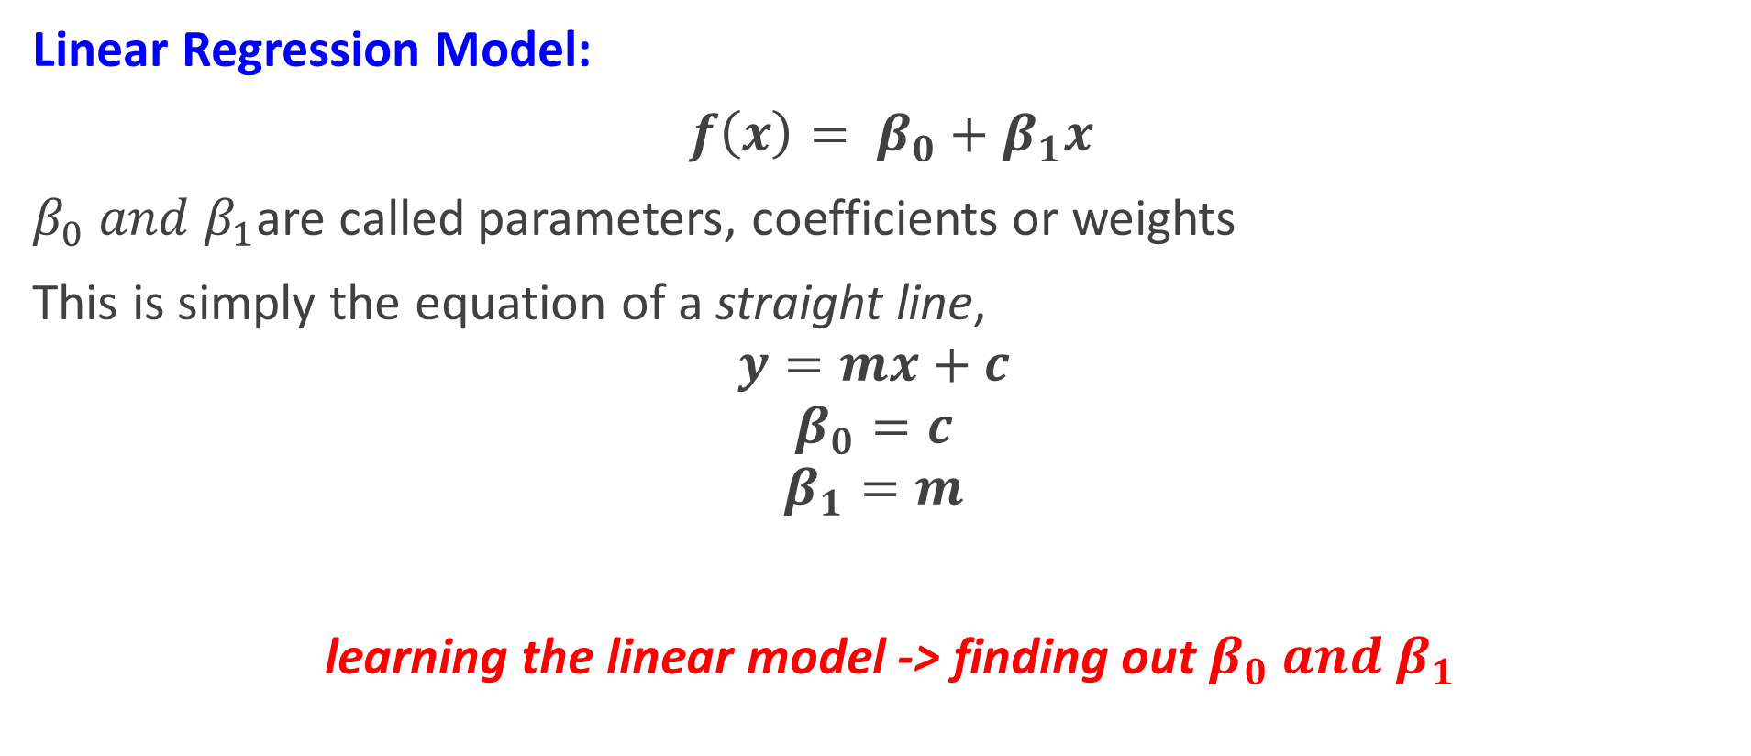
Linear Regression
Linear Regression Model:
$f\left(x\right)= β_{0}+β_{1}x$
$β_{0} and β_{1}$are called parameters, coefficients or weights
This is simply the equation of a straight line,
$$y=mx+c$$
$$β_{0}=c$$
$$β_{1}=m$$
learning the linear model -> finding out $β_{0} and β_{1}$

Slide 36
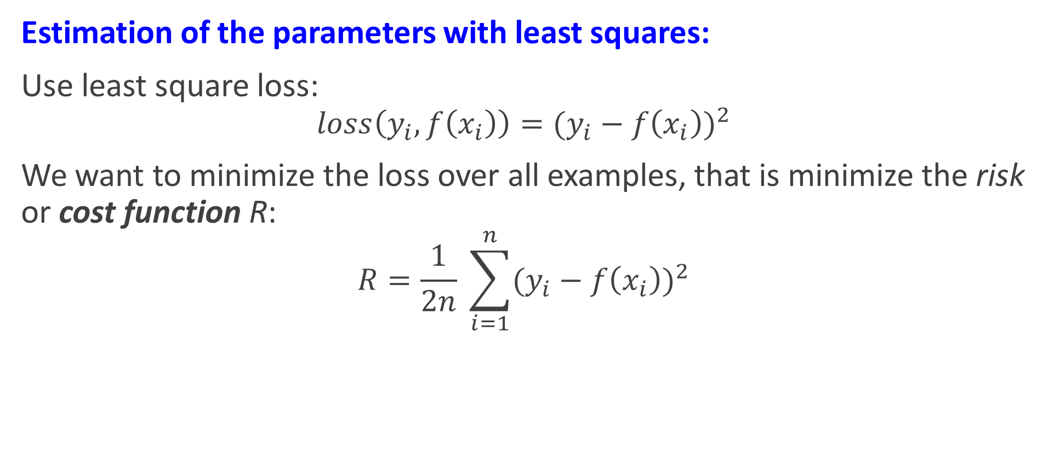
Linear Regression
Estimation of the parameters with least squares:
Use least square loss:
$$loss\left(y_{i},f\left(x_{i}\right)\right)={(y_{i}−f\left(x_{i}\right))}^{2}$$
We want to minimize the loss over all examples, that is minimize the risk or cost function R:
$$R=\frac{1}{2n} \sum_{i=1}^{n}{{(y_{i}−f\left(x_{i}\right))}^{2}}$$

Slide 37

Linear Regression
We want to minimize:
$$R=\frac{1}{2n} \sum_{i=1}^{n}{{(y_{i}−f\left(x_{i}\right))}^{2}}$$
$$R(β)=\frac{1}{2n} \sum_{i=1}^{n}{{(y_{i}−β_{0}−β_{1}x_{i} )}^{2}}$$
Find $β_{0} and β_{1}$ that minimize:
$$R(β)=\frac{1}{2n} \sum_{i=1}^{n}{{(y_{i}−β_{0}−β_{1}x_{i} )}^{2}}$$

Slide 38
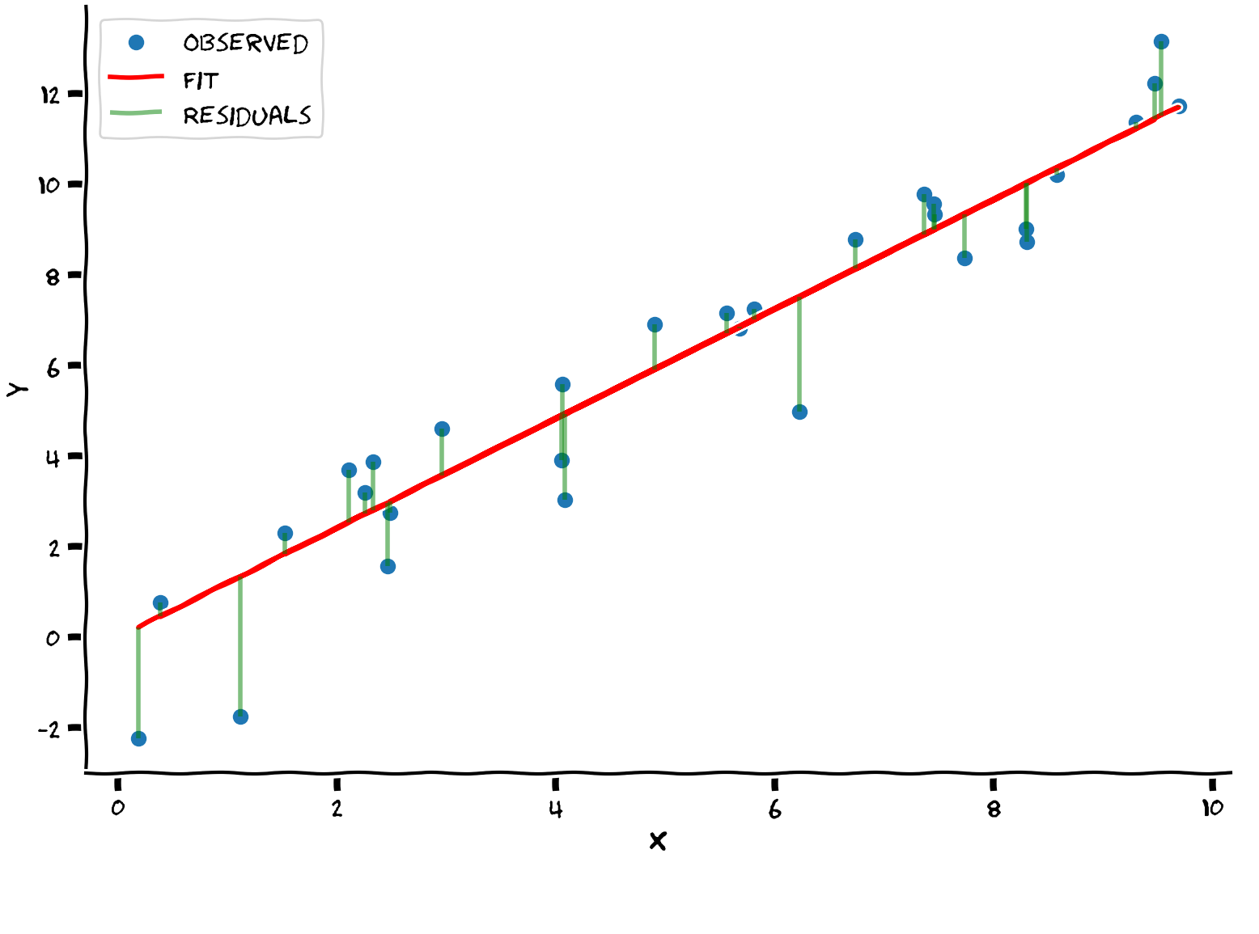
Supervised Learning
Calculating the Residuals (Errors)

Slide 39

Linear Regression
By using calculus, the following values can be derived
$$β_{1}=\frac{\sum_{i=1}^{n}{y_{i}x_{i}}−\frac{1}{n}\sum_{i=1}^{n}{y_{i}}\sum_{i=1}^{n}{x_{i}}}{\sum_{i=1}^{n}{{x_{i}}^{2}}−\frac{1}{n}\sum_{i=1}^{n}{x_{i}}\sum_{i=1}^{n}{x_{i}}}$$
$$β_{0}=\frac{1}{n}\sum_{i=1}^{n}{y_{i}}−β_{1}\frac{1}{n}\sum_{i=1}^{n}{x_{i}}$$

Slide 40
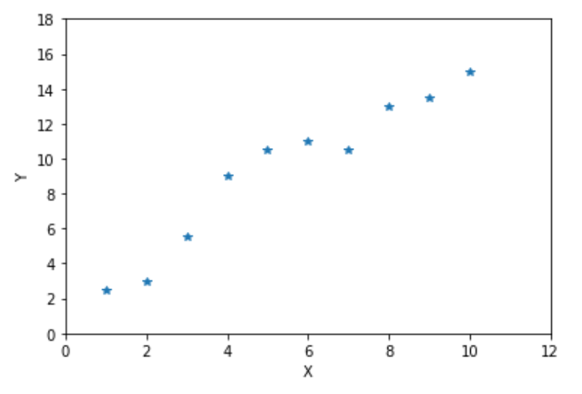
Linear Regression example
Data
X | Y
1 | 2.5
2 | 3
3 | 5.5
4 | 9
5 | 10.5
6 | 11
7 | 10.5
8 | 13
9 | 13.5
10 | 15

Slide 41
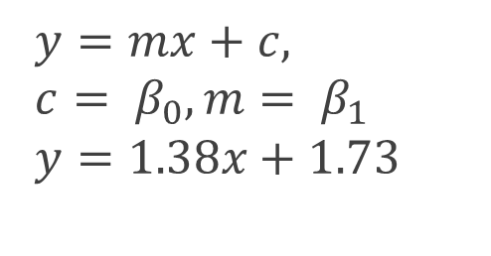

Linear Regression example
X | Y
1 | 2.5
2 | 3
3 | 5.5
4 | 9
5 | 10.5
6 | 11
7 | 10.5
8 | 13
9 | 13.5
10 | 15
$$β_{1}=\frac{\sum_{i=1}^{n}{y_{i}x_{i}}−\frac{1}{n}\sum_{i=1}^{n}{y_{i}}\sum_{i=1}^{n}{x_{i}}}{\sum_{i=1}^{n}{{x_{i}}^{2}}−\frac{1}{n}\sum_{i=1}^{n}{x_{i}}\sum_{i=1}^{n}{x_{i}}},β_{0}=\frac{1}{n}\sum_{i=1}^{n}{y_{i}}−β_{1}\frac{1}{n}\sum_{i=1}^{n}{x_{i}}$$
$$β_{1}=\text{1.38},β_{0}=\text{1.73}$$
$f\left(x\right)= β_{0}+β_{1}x$
$f\left(x\right)$ = $1.73+1.38x$
$$y=mx+c,$$
$${c= β}_{0},m= β_{1}$$
$$y=1.38x+1.73$$

Slide 42
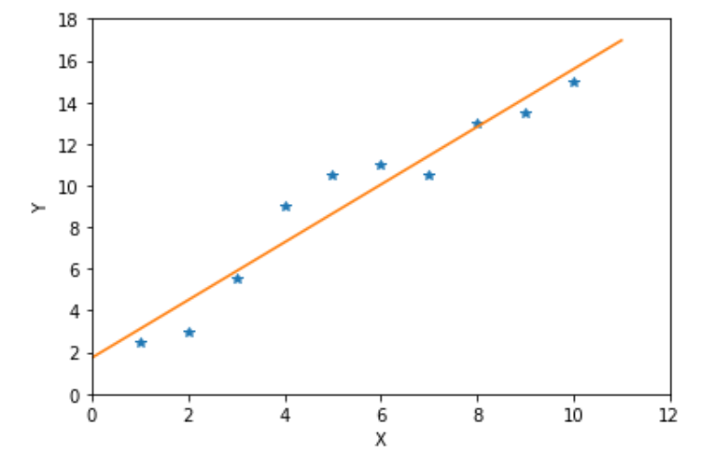

Linear Regression example
X | Y
1 | 2.5
2 | 3
3 | 5.5
4 | 9
5 | 10.5
6 | 11
7 | 10.5
8 | 13
9 | 13.5
10 | 15
$$y=mx+c,$$
$${c= β}_{0},m= β_{1}$$
$$y=1.38x+1.73$$

Slide 43
Linear Regression example
X | Y
1 | 2.5
2 | 3
3 | 5.5
4 | 9
5 | 10.5
6 | 11
7 | 10.5
8 | 13
9 | 13.5
10 | 15

Slide 44

Linear Regression example
X | Y
1 | 2.5
2 | 3
3 | 5.5
4 | 9
5 | 10.5
6 | 11
7 | 10.5
8 | 13
9 | 13.5
10 | 15
$$y=1.38x+1.73$$

Slide 45
Limitations of Linear Regression
Linear Assumption: Assumes that the relationship between the independent and dependent variables is linear, which may not always be the case in real-world data.
Sensitive to Outliers: Linear regression is sensitive to outliers. A few extreme points can have a large impact on the slope and the intercept.
Multicollinearity: When independent variables are highly correlated with each other, it can distort the coefficients and make it difficult to interpret the model.
Overfitting: With too many features, the model may overfit the training data and perform poorly on unseen data.

Slide 46
Ridge and Lasso Regression
Ridge and Lasso regression are both regularization techniques that help improve the performance of linear regression models by preventing overfitting.
Regularization adds a penalty term to the linear regression cost function, discouraging the model from becoming too complex. This added penalty term modifies the objective function, reducing the impact of less important features.
both extensions of Linear Regression that are used to address some of its limitations, particularly when dealing with multicollinearity (high correlation between features) and overfitting
Both methods introduce regularization (or penalty) terms to the linear regression model to control the complexity of the model. This helps improve the model’s generalization to unseen data.

Slide 47
Ridge Regression
Ridge regression, also known as L2 regularization
adds a penalty equal to the sum of the squares of the coefficients. It aims to reduce the magnitude of the coefficients, effectively "shrinking" them toward zero.
Ridge regression is ideal when you want to retain all features but reduce their impact if they aren’t significantly contributing.
Reduces overfitting by shrinking large coefficients.
Keeps all features but limits their influence on the model.
Often useful when dealing with multicollinearity (correlated predictors).

Slide 48
Lasso Regression
Lasso regression, or L1 regularization, adds a penalty equal to the sum of the absolute values of the coefficients.
Unlike Ridge, Lasso can shrink some coefficients exactly to zero, effectively performing feature selection by eliminating irrelevant features.
Can drive certain feature coefficients to zero, thereby excluding them from the model.
Reduces overfitting and provides a more interpretable model by selecting only the most important features.
Suitable when only a subset of predictors is expected to be relevant.

Slide 49
Ridge: Shrinks coefficients without reducing them to zero; all features remain in the model.
Lasso: Shrinks some coefficients to zero, effectively performing feature selection.

Slide 50
the terms L1 and L2 come from mathematics, specifically norms in linear algebra.
L1 (or Manhattan distance) measures distances based on absolute values.
L2 (or Euclidean distance) measures distances based on squared values.

Slide 51
# Apply Ridge Regression
ridge = Ridge(alpha=1.0) # alpha is the regularization parameter
ridge.fit(X_train, y_train)
ridge_predictions = ridge.predict(X_test)
# Apply Lasso Regression
lasso = Lasso(alpha=1.0)
lasso.fit(X_train, y_train)
lasso_predictions = lasso.predict(X_test)

Slide 52
End of Lecture 4

Slide 53
Thank you ! Any questions ?

